Slide 1
Determining which variables contribute to shot success rate in soccer
Michael Womble, Daniel Diaz, Rose Mesina, and Ganesh Ghimire
February 2, 2022

Slide 2







Data Set Overview:
1,974 Matches
2016:
3,251,294 events & 18 variables
2017/2018:
2018:

Slide 3
Variables:
Event Name
Subevent Name
Event Time
Event Coordinates
Player
Shots
Pass
Free Kick
Simple Pass
Cross
Goal Kick
x, y
start
end
Event Name
Team
Match Date
Tags
Goals
Assist
Key Passes

Slide 4
Variables:
Event Name
Subevent Name
Event Time
Event Coordinates
Player
Shots
Pass
Free Kick
Simple Pass
Cross
Goal Kick
x, y
start
end
Event Name
Team
Match Date
Tags
Goals
Assist
Key Passes

Slide 5
SMART Question:
Based on the matches played during the 2017/2018 season for Europe’s top five leagues, the 2016 European Championship, and the 2018 World Cup, which match variables (ex: shot location, assist location, assist distance, etc…) result in the highest probability of a shot on goal being successful, result in a goal?

Slide 6

Approach:
Shots
Location
Assists
Distance
Key Passes

Slide 7
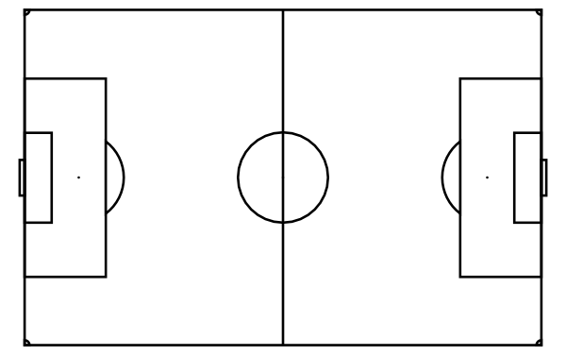
Understanding Field Coordinates:
100
y-coordinate
(x,y)
distance
Attack
(x,y)
0
0
x-coordinate
100

Slide 8
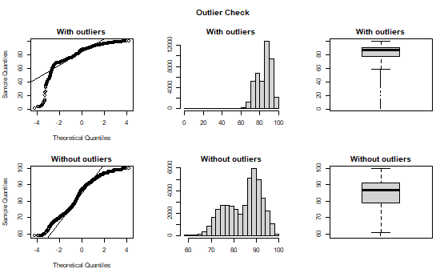
Checking for Outliers:
Example: Shots

Slide 9
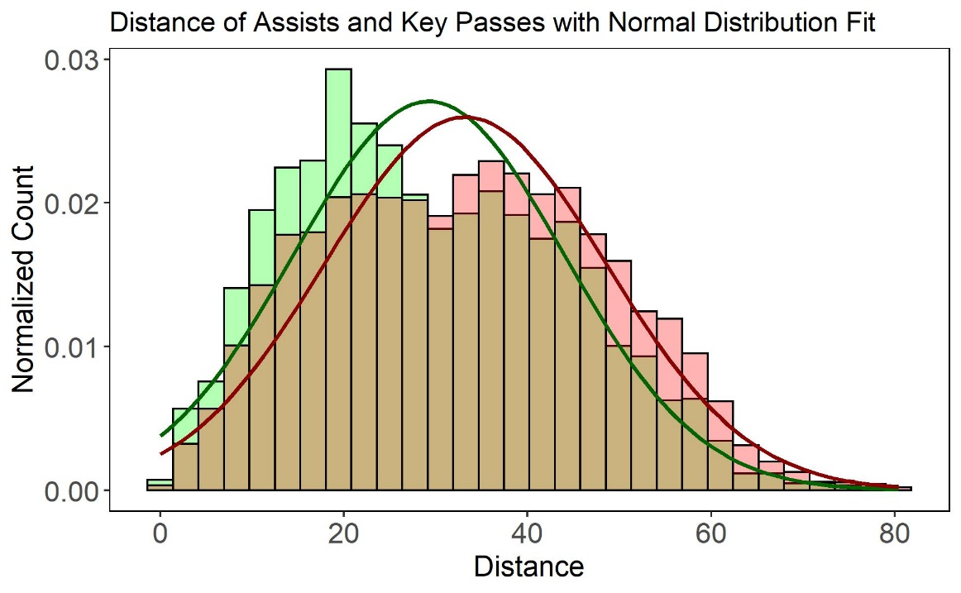
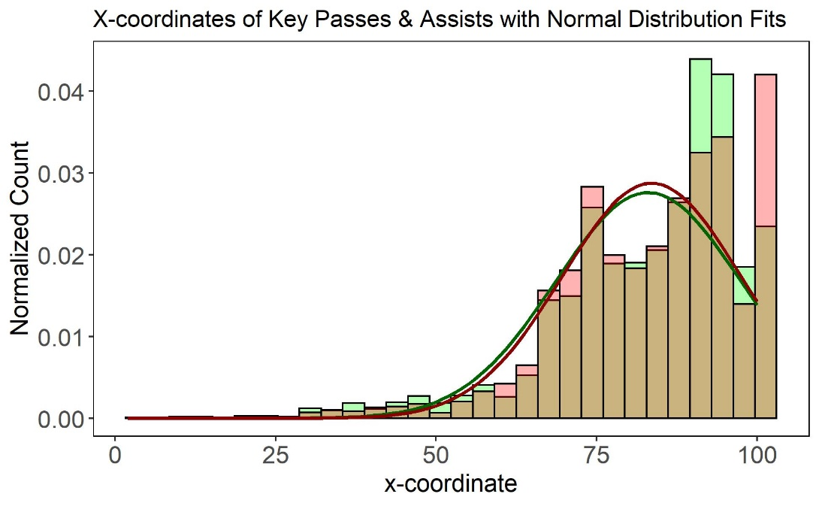
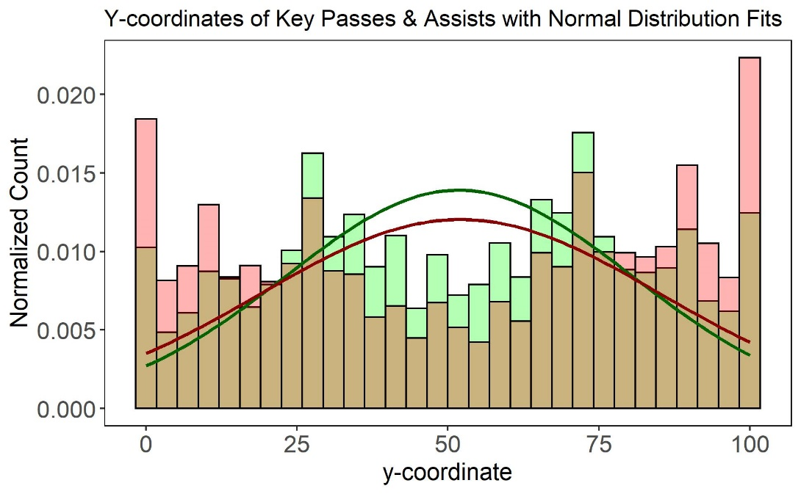
Assist vs Key Pass

Slide 10
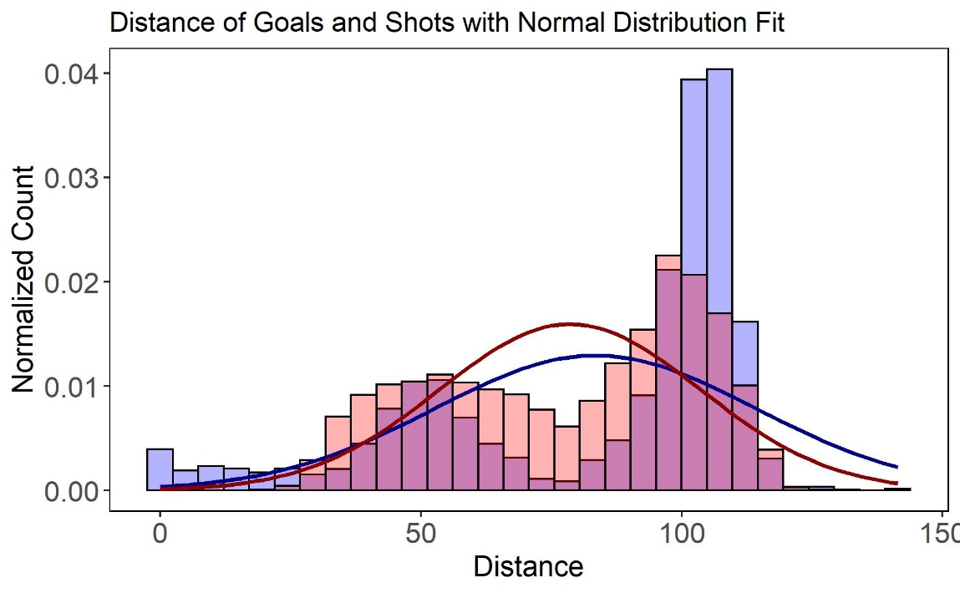
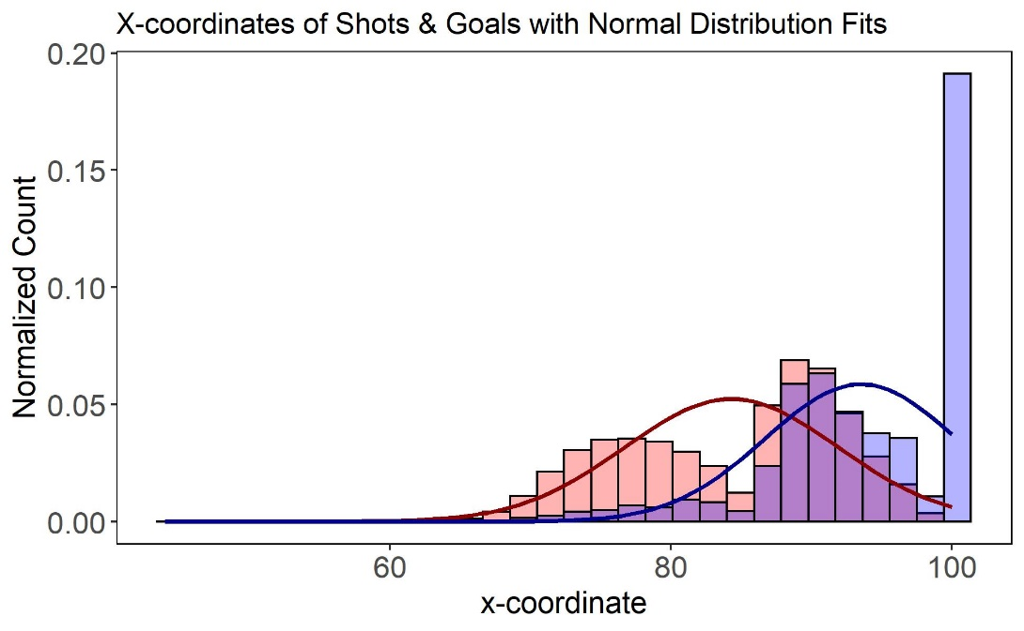
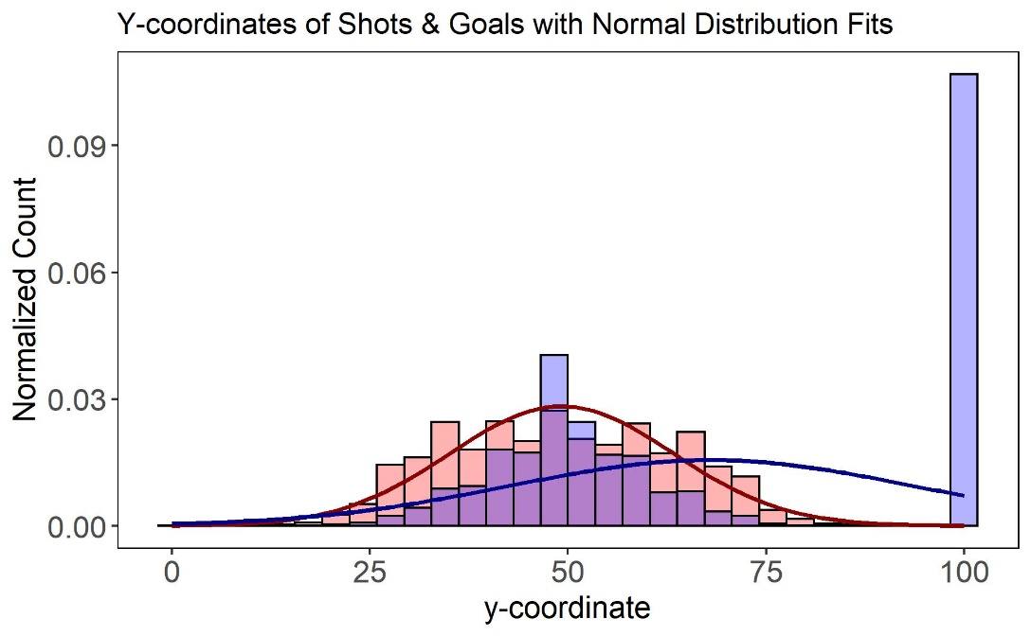
Shot vs Goal

Slide 11
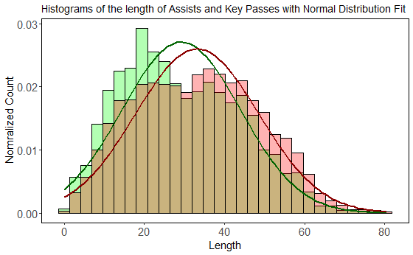
Length of Assists and Key Passes:

Slide 12
Conclusions:

